Slide 1

ME EN 6960: Experimental Methods in Solid Mechanics
Dynamic Fracture
References:
Dynamic Fracture Mechanics, L.B. Freund, Cambridge Press 1990
Experimental Techniques in Fracture, J.S. Epstein, SEM 1993
Fracture Mechanics, T.L. Anderson, CRC Press, NY 1994
Handbook on Experimental Mechanics, Kobayashi, SEM 1987
Dynamic Behavior of Materials, M.A. Meyers, Wiley, 1994
© Owen Kingstedt, 2018
ME EN 6960: Spring 2018

Slide 2
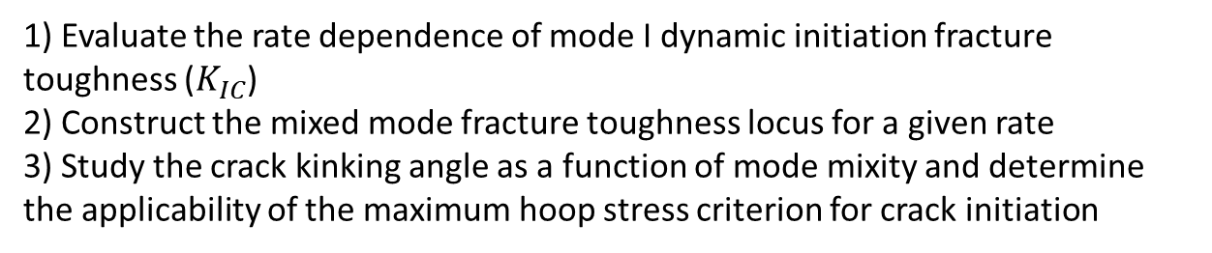
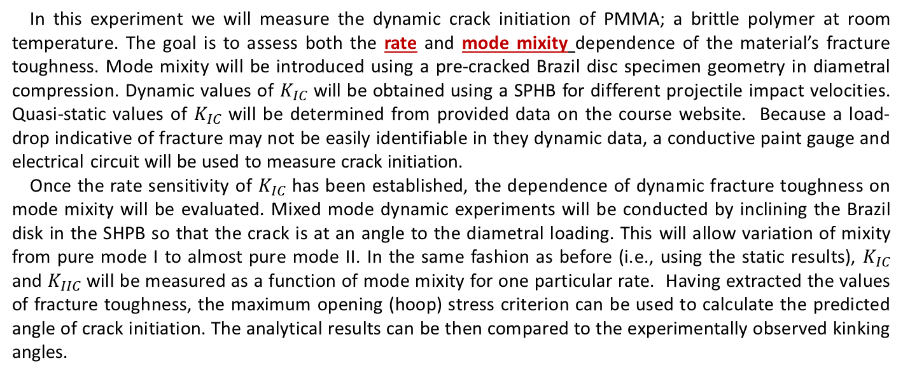
Experiment Four
2
Measurement of dynamic initiation fracture toughness
Goals:
1) Evaluate the rate dependence of mode I dynamic initiation fracture toughness ($K_{IC}$)
2) Construct the mixed mode fracture toughness locus for a given rate
3) Study the crack kinking angle as a function of mode mixity and determine the applicability of the maximum hoop stress criterion for crack initiation
In this experiment we will measure the dynamic crack initiation of PMMA; a brittle polymer at room temperature. The goal is to assess both the rate and mode mixity dependence of the material’s fracture toughness. Mode mixity will be introduced using a pre-cracked Brazil disc specimen geometry in diametral compression. Dynamic values of $K_{IC}$ will be obtained using a SPHB for different projectile impact velocities. Quasi-static values of $K_{IC}$ will be determined from provided data on the course website. Because a load-drop indicative of fracture may not be easily identifiable in they dynamic data, a conductive paint gauge and electrical circuit will be used to measure crack initiation.
Once the rate sensitivity of $K_{IC}$ has been established, the dependence of dynamic fracture toughness on mode mixity will be evaluated. Mixed mode dynamic experiments will be conducted by inclining the Brazil disk in the SHPB so that the crack is at an angle to the diametral loading. This will allow variation of mixity from pure mode I to almost pure mode II. In the same fashion as before (i.e., using the static results), $K_{IC}$ and $K_{IIC}$ will be measured as a function of mode mixity for one particular rate. Having extracted the values of fracture toughness, the maximum opening (hoop) stress criterion can be used to calculate the predicted angle of crack initiation. The analytical results can be then compared to the experimentally observed kinking angles.
© Owen Kingstedt, 2018
ME EN 6960: Spring 2018

Slide 3
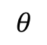
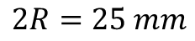
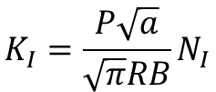
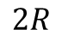
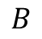
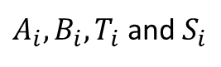
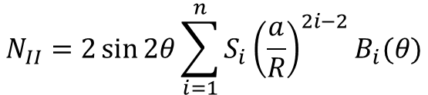
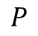
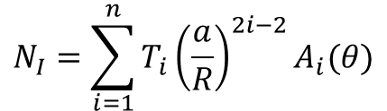
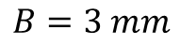
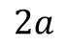
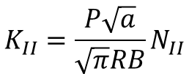
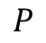
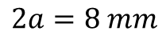
Experiment Four
3
Brazil disk fracture specimen:
Conductive Ag paint
$$2a$$
$$P$$
$$θ$$
$$P$$
Nominal specimen dimensions:
$$2R=25 mm$$
$$2a=8 mm$$
$$2R$$
$$B$$
$$B=3 mm$$
$$K_{I}=\frac{P\sqrt{a}}{\sqrt{π}RB}N_{I}$$
$$N_{I}=\sum_{i=1}^{n}{T_{i}{\left(\frac{a}{R}\right)}^{2i−2}A_{i}(θ)}$$
For values of
$A_{i},B_{i},T_{i}$ and $S_{i}$
consult Atkinson et al, 1982;
Shetty et al, 1987
$$K_{II}=\frac{P\sqrt{a}}{\sqrt{π}RB}N_{II}$$
$$N_{II}=2\sin{2θ}\sum_{i=1}^{n}{S_{i}{\left(\frac{a}{R}\right)}^{2i−2}B_{i}(θ)}$$
© Owen Kingstedt, 2018
ME EN 6960: Spring 2018

Slide 4
Experiment Four
4
References:
• Atkinson, C., R. E. Smelser, and Jo Sanchez. "Combined mode fracture via the cracked Brazilian disk test." International Journal of Fracture 18.4 (1982): 279-291.
• Shetty, Dinesh K., Alan R. Rosenfield, and Winston H. Duckworth. "Mixed-mode fracture in biaxial stress state: application of the diametral-compression (Brazilian disk) test." Engineering Fracture Mechanics 26.6 (1987): 825-840.
• Nakano, M., et al. "Dynamic fracture initiation in brittle materials under combined mode I/II loading." Le Journal de Physique IV 4.C8 (1994): C8-695.
• Awaji, Hideo, and Sennosuke Sato. "Combined mode fracture toughness measurement by the disk test." Journal of Engineering Materials and Technology 100.2 (1978): 175-182.
• Jia, Z., A. Castro-Montero, and S. P. Shah. "Observation of mixed mode fracture with center notched disk specimens." Cement and Concrete research 26.1 (1996): 125-137.
© Owen Kingstedt, 2018
ME EN 6960: Spring 2018

Slide 5
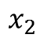
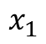
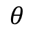
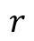
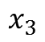
Outline
5
Introduction
Stationary Cracks
• Dynamic Loading
• Initiation criterion
Crack front
$$x_{2}$$
$$r$$
$$θ$$
$$x_{1}$$
Growing Cracks – Mode I
• Asymptotic fields
• Crack tip equation of motion
• Limiting speed
• Transient effects
• Crack arrest
$$x_{3}$$
Crack faces
Crack plane
Shear Cracks
• Failure mode transition
• Dynamic interfacial fracture
• Intersonic crack growth
© Owen Kingstedt, 2018
ME EN 6960: Spring 2018

Slide 6
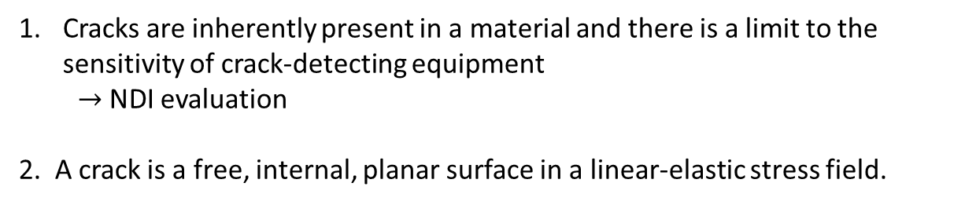
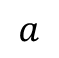
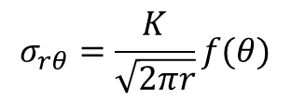
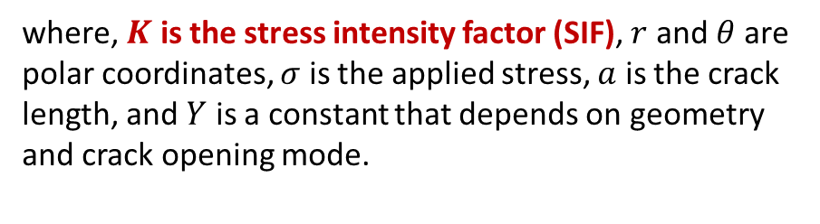
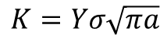
Introduction – LEFM Revisited
6
Basic Hypotheses of LEFM
Cracks are inherently present in a material and there is a limit to the sensitivity of crack-detecting equipment
$→$NDI evaluation
2. A crack is a free, internal, planar surface in a linear-elastic stress field.
$$x_{2}$$
3. The elastic solution furnishes a stress near the crack tip as:
Crack front
$$r$$
$$σ_{rθ}=\frac{K}{\sqrt{2πr}}f(θ)$$
$$θ$$
$$K=Yσ\sqrt{πa}$$
$$x_{1}$$
where, $K$ is the stress intensity factor (SIF), $r$ and $θ$ are polar coordinates, $σ$ is the applied stress, $a$ is the crack length, and $Y$ is a constant that depends on geometry and crack opening mode.
$$x_{3}$$
Crack faces
Crack plane
$$a$$
• Investigated in Lab 2
4. The crack growth leading to failure is predicted based on the tensile stress acting at the crack tip.
© Owen Kingstedt, 2018
ME EN 6960: Spring 2018

Slide 7
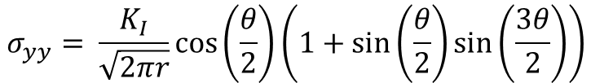
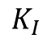
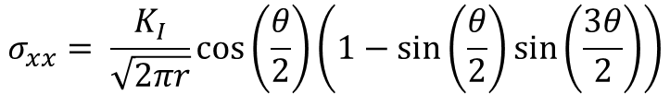
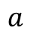
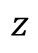
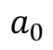
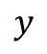
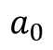
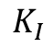
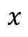
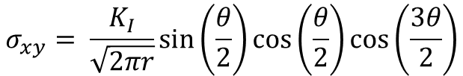
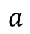
Introduction – LEFM Revisited
7
$$y$$
In LEFM, loads are felt simultaneously over all of the body
Body under load has a stiffness which works against the applied load, resulting in a displacement field satisfying equilibrium equations.
Westergaard
solution:
$$σ_{xx}= \frac{K_{I}}{\sqrt{2πr}}\cos\left(\frac{θ}{2}\right)\left(1−\sin\left(\frac{θ}{2}\right)\sin\left(\frac{3θ}{2}\right)\right)$$
$$x$$
$$z$$
$$σ_{yy}= \frac{K_{I}}{\sqrt{2πr}}\cos\left(\frac{θ}{2}\right)\left(1+\sin\left(\frac{θ}{2}\right)\sin\left(\frac{3θ}{2}\right)\right)$$
$$σ_{xy}= \frac{K_{I}}{\sqrt{2πr}}\sin\left(\frac{θ}{2}\right)\cos\left(\frac{θ}{2}\right)\cos\left(\frac{3θ}{2}\right)$$
For crack initiation:
Brittle solids
Ductile solids
$$K_{I}$$
$$K_{I}$$
LEFM
$$a_{0}$$
$$a$$
$$a$$
$$a_{0}$$
© Owen Kingstedt, 2018
ME EN 6960: Spring 2018
Notes:
Note there is no time dependence the solution

Slide 8
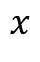
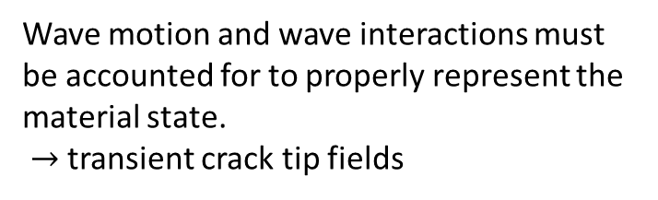
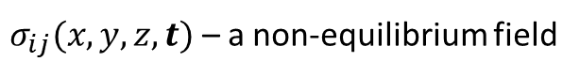
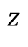
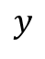
Introduction – Dynamic fracture
8
“Dynamic fracture mechanics is the subfield of fracture mechanics concerned with fracture phenomena for which the role of material inertia becomes significant”
- L. B. Freud, 1990
$$y$$
In dynamic fracture mechanics, loads felt by a material point are dependent on time:
Material stiffness and inertial resistance to loading evolve.
Point 1
$$x$$
$σ_{ij}(x,y,z,t)$ – a non-equilibrium field
$$z$$
Wave motion and wave interactions must be accounted for to properly represent the material state.
$→$ transient crack tip fields
Point 2
© Owen Kingstedt, 2018
ME EN 6960: Spring 2018

Slide 9
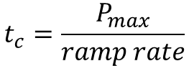
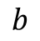
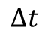
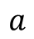
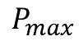
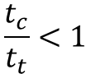
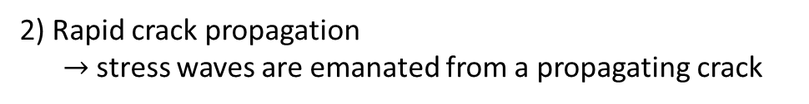



Introduction – Dynamic fracture
9
Question: When is material inertia significant?
1) Rapid loading application
$→$ stress wave interactions with a stationary crack
$→$ strain-rate dependent material response
Geometry is important too.
2) Rapid crack propagation
$→$ stress waves are emanated from a propagating crack
Rule of thumb:
$$P_{max}$$
Characteristic time:
Minimal inertia effects when,
Ramp
rate
$$t_{c}=\frac{P_{max}}{ramp rate}$$
$$\frac{t_{c}}{t_{t}}>1$$
$$Δt$$
crack
Transmission time:
Significant inertia effects when,
$$t_{t}=\frac{a}{c_{L}}$$
$$\frac{t_{c}}{t_{t}}<1$$
$$a$$
$$b$$
© Owen Kingstedt, 2018
ME EN 6960: Spring 2018
Notes:
The denominator of the characteristic time gets larger the faster the jump in the loading state.

Slide 10






Introduction
10
A 3-D symmetric problem: spherical cavity in an infinite body where a jump in pressure $p\left(t\right)$ is applied. ($p(0)=0$ and $p(>0) = const.)$
Using elasto-statics,
$$r$$
$σ\left(r,θ\right)\sim r^{−3}$ (elliptical equilibrium field)
Using elasto-dynamics,
$σ(r,θ)\sim r^{−1}$ (hyperbolic wave field)
$$p$$
dynamic
static
Take-away: During dynamic fracture mechanics, wave interactions with the stationary (or propagating crack) can lead to stress intensity factors (SIFs) greater than the elasto-statics stress intensity factors.
$→$ Stress intensity factors become field and time dependent!!
© Owen Kingstedt, 2018
ME EN 6960: Spring 2018

Slide 11














Outline
11
Introduction
$$c_{d}$$
$$y$$
$$c_{d}$$
Stationary Cracks
• Dynamic Loading
• Initiation criterion
$$c_{s}$$
$$x$$
$$c_{R}$$
$$c_{s}$$
Growing Cracks – Mode I
• Asymptotic fields
• Crack tip equation of motion
• Limiting speed
• Transient effects
• Crack arrest
$$c_{d}$$
$$y$$
$$L$$
$$x$$
Shear Cracks
• Failure mode transition
• Dynamic interfacial fracture
• Intersonic crack growth
$$σ^{∗}$$
$$c_{d}$$
$$t^{∗}$$
© Owen Kingstedt, 2018
ME EN 6960: Spring 2018

Slide 12










Stationary Cracks
12
Fundamental Assumptions:
Small strain formulation of continuum mechanics
Cracks are planar features
In-plane fields only ($u_{z}$ is independent of $u_{x}$ and $u_{y}$)
Wave motion/interaction will play a role in the stresses experienced at a material point, therefore, we must revise our near crack stress field:
$$σ_{ij}= \frac{K\left(t\right)}{\sqrt{2πr}}Σ_{ij}\left(θ\right)+σ_{ij}^{(1)}+o(1)$$
$$Σ_{11}\left(θ\right)=\cos{\frac{θ}{2}}\left(1−\sin{\frac{θ}{2}}\sin{\frac{3θ}{2}}\right)$$
$K\left(t\right)$: time dependent elastic SIF
$Σ_{ij}\left(θ\right):$ angular stress field variation
• $Σ_{ij}\left(0\right)=1$
$$Σ_{12}\left(θ\right)=\cos{\frac{θ}{2}}\sin{\frac{θ}{2}}\cos{\frac{3θ}{2}}$$
$σ_{ij}^{(1)}$: order unity crack tip contribution
$$Σ_{22}\left(θ\right)=\cos{\frac{θ}{2}}\left(1+\sin{\frac{θ}{2}}\sin{\frac{3θ}{2}}\right)$$
• $σ_{i2}^{(1)}=0$ for $i=1,2,3$ when a crack is traction free
$$σ_{ij}^{(1)}=\lim_{r→0}\left\{σ_{ij}−\frac{K\left(t\right)}{\sqrt{2πr}}Σ_{ij}\left(θ\right)\right\}$$
© Owen Kingstedt, 2018
ME EN 6960: Spring 2018
Notes:
K(t) is not a material property it is a description of a time dependent stress field

Slide 13


















Stationary Crack – Mode I
13
Mode-I crack under sudden normal traction along the crack surface in an infinite LEHI body
$$c_{d}$$
Traction boundary conditions:
$$y$$
$$c_{d}$$
$$T_{x}\left(x,y,t\right)=T_{z}\left(x,y,t\right)=0$$
$$σ^{∗}$$
For $y= ±0$
$$T_{y}\left(x,y,t\right)= ±σ^{∗}H(t)$$
$$c_{s}$$
Symmetry conditions:
$$x$$
$$u_{x}\left(x,−y,t\right)=u_{x}\left(x,y,t\right)$$
$$u_{y}\left(x,−y,t\right)=u_{y}\left(x,y,t\right)$$
$$c_{s}$$
Implies,
$$u_{y}\left(x,0,t\right)=0$$
$$σ_{xy}\left(x,0,t\right)=0$$
for $x>0$
$$σ^{∗}$$
$$c_{d}$$
Near the crack tip the stress field will be $K_{I}(t)$dominated, fields are homogeneous, $\sqrt{r}$ variation in the stresses:
$$σ_{yy}\sim C_{I}σ^{∗}\sqrt{\frac{c_{d}t}{x}}$$
where, $C_{I}$ is a dimensionless constant
$$K_{I}\left(t\right)=\lim_{x→0^{+}}{\sqrt{2πx}}σ_{yy}\left(x,0,t\right)$$
$=C_{I}σ^{∗}\sqrt{2πx}$
© Owen Kingstedt, 2018
ME EN 6960: Spring 2018
Notes:
The stress intensity factor is known up to the value of C_I

Slide 14









Stationary Crack – Mode I
14
We can derive an analytical solution to determine the time history of $K_{I}\left(t\right).$
$→$The Wiener-Hopf approach (Freund 1990, pg 77-93)
$$c_{d}$$
$$y$$
$$c_{d}$$
$$c_{s}$$
$$K_{I}\left(t\right)=2σ^{∗}\frac{\sqrt{c_{d}t\left(1−2ν\right)}}{\left(1−ν\right)\sqrt{π}}$$
$$x$$
$$c_{s}$$
$$c_{d}$$
The normal stress on the crack plane for a material with $ν=0.3$
Dynamic solution
Singular solution
© Owen Kingstedt, 2018
ME EN 6960: Spring 2018
Notes:
The stress intensity factor is known up to the value of C_I

Slide 15










Stationary Crack – Mode II
15
We can derive an analytical solution to determine the time history of $K_{II}\left(t\right).$
$$y$$
$$c_{d}$$
$$c_{s}$$
$$c_{s}$$
$$K_{II}\left(t\right)=2τ^{∗}\sqrt{\frac{2c_{s}t}{π(1−ν)}}$$
$$τ^{∗}$$
$$x$$
$$c_{s}$$
$$c_{s}$$
Shear wave arrival
The shear stress on the crack plane for a material with $ν=0.3$
Dynamic soln
Singular soln
Freund, 1990
© Owen Kingstedt, 2018
ME EN 6960: Spring 2018
Notes:
The stress intensity factor is known up to the value of C_I

Slide 16






Stationary Crack – Initiation
16
A stationary crack,
$$σ_{0}H(t)$$
For,
$$0<t<L/{c_{d}}$$
$$y$$
$$K_{I}\left(t\right)=2σ_{0}\frac{\sqrt{c_{d}t(1−2ν)}}{\left(1−ν\right)\sqrt{π}}$$
$$x$$
$$L$$
Rayleigh wave
Shear wave
Waves are generated at each crack tip
$$c_{d}$$
$$y$$
$$c_{d}$$
$$c_{s}$$
$$x$$
Dilatational wave
$$c_{R}$$
Position plotted to the right
$$c_{s}$$
Freund, 1990
$$c_{d}$$
© Owen Kingstedt, 2018
ME EN 6960: Spring 2018
Notes:
Here L is our characteristic length

Slide 17













Stationary Crack – Initiation
17
Penny shaped crack
$$y$$
For a dynamic case assuming, $σ_{0}=σ_{crit},$ where, $σ_{0}$is the smallest applied stress to satisfy criterion
$$L$$
$$x$$
Leading edge of a propagating pulse
$$σ^{∗}$$
$$c_{d}$$
$$t^{∗}$$
When ${tc_{R}}/L≫1$
• short crack
• long pulse duration
When ${tc_{R}}/L≪1$
• long crack
• short pulse duration
$$K_{I}^{max}≈1.3σ_{0}\sqrt{\frac{πL}{2}}$$
$$K_{I}^{max}≈1.6σ_{0}\sqrt{t_{0}c_{R}}$$
$$K_{I}(t)$$
$$K_{I}(t)$$
$$\frac{σ_{cr}\sqrt{L}}{K_{IC}}≈0.6$$
$$\frac{σ_{cr}\sqrt{L}}{K_{IC}}≈0.6\sqrt{\frac{L}{t_{0}c_{R}}}$$
$$t$$
$$t$$
$$t^{∗}$$
$$t^{∗}$$
© Owen Kingstedt, 2018
ME EN 6960: Spring 2018
Notes:
Here L is our characteristic length

Slide 18






Stationary Crack – Initiation
18
Experimental results compared to fits of the normalized stress amplitude and pulse length to satisfy a stress intensity factor criterion.
$$1/\sqrt{x}$$
$$15 MPa<σ_{0}<35 MPa$$
$$v$$
$$0.4mm<L<12.7mm$$
Epoxy
$$K_{IC}=1.1 MPa \sqrt{m}$$
$$K_{IC}=0.72 MPa \sqrt{m}$$
Long crack response
Crack growth
Short crack response
No-crack growth
Shockey et al, IJF, 1983
Freund 1990
© Owen Kingstedt, 2018
ME EN 6960: Spring 2018
Notes:
Here L is our characteristic length

Slide 19





Stationary Crack – Measurement of $K_{I}(t)$
19
Boundary/load displacement measurements
Strain Gauges
Optical techniques, e.g., caustics, coherent gradient sensing, Twyman-Green, Moiré
$$y$$
$$K_{I}(t)∝{D(t)}^{5/2}$$
$$x$$
$$D$$
© Owen Kingstedt, 2018
ME EN 6960: Spring 2018
Notes:
Here L is our characteristic length

Slide 20
Stationary Crack – Rate Effects
20
Investigation of the relationship between impact fracture toughness of PMMA and dynamic stress intensity factor
Wada et al, EFM, 1993
© Owen Kingstedt, 2018
ME EN 6960: Spring 2018
Notes:
Here L is our characteristic length

Slide 21










Outline
21
$$σ_{θθ}$$
Introduction
$$r$$
$$σ_{θθ}$$
Stationary Cracks
• Dynamic Loading
• Initiation criterion
$$θ$$
$$v\left(t\right)$$
$$σ_{11}$$
Growing Cracks – Mode I
• Asymptotic fields
• Crack tip equation of motion
• Limiting speed
• Transient effects
• Crack arrest
$$r$$
$$θ$$
$$σ_{11}$$
$$v\left(t\right)$$
Shear Cracks
• Failure mode transition
• Dynamic interfacial fracture
• Intersonic crack growth
$$r$$
$$θ$$
$$v\left(t\right)$$
© Owen Kingstedt, 2018
ME EN 6960: Spring 2018

Slide 22

















Growing Crack – Asymptotic Fields
22
Steady state mode 1 crack growth:
$$x_{2}$$
Stress field around the crack tip:
$$v\left(t\right)=const.$$
$$σ_{ij}\left(r,θ,t\right)=\frac{K_{I}^{d}\left(t\right)}{\sqrt{2πr}}Σ_{ij}^{I}\left(θ,ν\right)+σ_{ij}^{(I)}$$
$$x_{1}$$
$${∂v}/{∂t}=0$$
$$σ_{12}^{(1)}=0$$
$$v\left(t\right)$$
$$Σ_{11}^{I}\left(θ,v\right)=\frac{1}{D(v)}\left\{ \left(1+α_{s}^{2}\right)\left(1+2α_{d}^{2}−α_{s}^{2}\right)\frac{\cos\left({θ_{d}}/2\right)}{\sqrt{γ_{d}}}−4α_{s}α_{d}\frac{\cos\left({θ_{s}}/2\right)}{\sqrt{γ_{s}}}\right\}$$
$$Σ_{12}^{I}\left(θ,v\right)=−\frac{1}{D(v)}\left\{ \left(1+α_{s}^{2}\right)\frac{\cos\left({θ_{d}}/2\right)}{\sqrt{γ_{d}}}−4α_{s}α_{d}\frac{\cos\left({θ_{s}}/2\right)}{\sqrt{γ_{s}}}\right\}$$
$$Σ_{22}^{I}\left(θ,v\right)=\frac{2α_{d}(1+α_{s}^{2})}{D(v)}\left\{ \left(1+α_{s}^{2}\right)\frac{\sin\left({θ_{d}}/2\right)}{\sqrt{γ_{d}}}−\frac{\sin\left({θ_{s}}/2\right)}{\sqrt{γ_{s}}}\right\}$$
$$D\left(v\right)=4α_{s}α_{d}−{\left(1+α_{s}^{2}\right)}^{2}$$
$$α_{s}^{2}=1−v^{2}/c_{s}$$
$$γ_{s}^{2}=1−v^{2}\sin^{2}{θ}/c_{s}$$
$$\tan{θ_{s}}=α_{s}\tan{θ}$$
$$α_{d}^{2}=1−v^{2}/c_{d}$$
$$γ_{d}^{2}=1−v^{2}\sin^{2}{θ}/c_{d}$$
$$\tan{θ_{d}}=α_{d}\tan{θ}$$
© Owen Kingstedt, 2018
ME EN 6960: Spring 2018
Notes:
Here L is our characteristic length

Slide 23











Growing Crack – Asymptotic Fields
23
Elastodynamic particle velocity fields are also root singular:
$$\dot{u_{1}}=−\frac{vK_{I}^{d}(t)}{μD\sqrt{2πr}}\left\{ \left(1+α_{s}^{2}\right)\frac{\cos\left({θ_{d}}/2\right)}{\sqrt{γ_{d}}}−2α_{s}α_{d}\frac{\cos\left({θ_{s}}/2\right)}{\sqrt{γ_{s}}}\right\}$$
$$\dot{u_{2}}=−\frac{vα_{d}K_{I}^{d}(t)}{μD\sqrt{2πr}}\left\{ \left(1+α_{s}^{2}\right)\frac{\cos\left({θ_{d}}/2\right)}{\sqrt{γ_{d}}}−2\frac{\cos\left({θ_{s}}/2\right)}{\sqrt{γ_{s}}}\right\}$$
Energy to crack tip:
$$D\left(v\right)>0$$
$$0<v<c_{R} →σ_{22}\dot{u_{2}}>0$$
$$D\left(v\right)=0$$
$$v=c_{R}$$
$$D\left(v\right)<0$$
$$c_{R}<v →σ_{22}\dot{u_{2}}<0$$
Triaxiality:
$$\lim_{r→0}{\frac{σ_{22}(r,0,t)}{σ_{11}(r,0,t)}=\frac{D}{ \left(1+α_{s}^{2}\right)\left(1+2α_{d}^{2}−α_{s}^{2}\right) −4α_{s}α_{d}}=}$$
$1$ for $v=0$
$0$ for $v=c_{R}$
© Owen Kingstedt, 2018
ME EN 6960: Spring 2018
Notes:
Here L is our characteristic length

Slide 24





















Growing Crack – Asymptotic Fields
24
Can visualize the principle stresses about the crack tip using different approaches.
$$σ_{θθ}$$
Circumferential (Hoop) stress:
$$σ_{θθ}=\frac{K_{I}\left(t\right)}{\sqrt{2πr}}Σ_{θθ}^{I}(θ,v)$$
$$1.6$$
$$r$$
$$σ_{θθ}$$
$$θ$$
$$σ_{22}$$
$$1.2$$
$$v\left(t\right)$$
Observations:
$$0.8$$
$$v/c_{s}$$
When $v≤0.6 c_{s}$max stress occurs along the crack plane
$$Σ_{θθ}^{I}(θ,v)$$
$$0.4$$
$$0.8$$
$$0.7$$
$$0.6$$
$$0.4$$
$$0.0$$
When $v>0.6 c_{s}$max stress occurs at ~60⁰ to the crack plane
$$0.0$$
$$−0.4$$
$$0$$
$$30$$
$$60$$
$$90$$
$$120$$
$$150$$
$$180$$
$θ$ (deg.)
© Owen Kingstedt, 2018
ME EN 6960: Spring 2018
Notes:
Here L is our characteristic length

Slide 25



















Growing Crack – Asymptotic Fields
25
$$σ_{11}$$
$$σ_{11}=\frac{K_{I}\left(t\right)}{\sqrt{2πr}}Σ_{11}^{I}(θ,v)$$
Principal stress variation:
$$r$$
$$θ$$
$$σ_{11}$$
$$3.0$$
$$v/c_{s}$$
$$v\left(t\right)$$
$$2.5$$
$$0.8$$
$$0.7$$
$$0.6$$
$$0.4$$
$$0.0$$
Observations:
$$2.0$$
Opening stress on the crack plane increases drastically with increasing crack propagation velocity
$$Σ_{11}^{I}(θ,v)$$
$$1.5$$
$$1.0$$
Maximas at 0 and 105⁰
$$0.5$$
$$0.0$$
$$0$$
$$30$$
$$60$$
$$90$$
$$120$$
$$150$$
$$180$$
$θ$ (deg.)
© Owen Kingstedt, 2018
ME EN 6960: Spring 2018
Notes:
Here L is our characteristic length

Slide 26


















Growing Crack – Asymptotic Fields
26
$$τ_{max}=\frac{K_{I}\left(t\right)}{\sqrt{2πr}}Σ_{max}^{I}(θ,v)$$
Maximum shear stress:
$$2.0$$
$$r$$
$$θ$$
$$v/c_{s}$$
$$0.8$$
$$0.7$$
$$0.6$$
$$0.4$$
$$0.0$$
$$v\left(t\right)$$
$$1.5$$
Observations:
Monotonic increase in max shear stress with increasing crack speed for a fixed SIF level ($K_{I}(t)$)
$$1.0$$
$$Σ_{max}^{I}(θ,v)$$
$$0.5$$
Maximum shear stress does not lie on the crack plane
$$0.0$$
$$0$$
$$30$$
$$60$$
$$90$$
$$120$$
$$150$$
$$180$$
$θ$ (deg.)
© Owen Kingstedt, 2018
ME EN 6960: Spring 2018
Notes:
Here L is our characteristic length

Slide 27

Observation Interpretation
27
A brittle ceramic subjected to impact loading of increasing velocity
Takeaway: The greater the impact velocity (crack velocity) the greater the presence of crack bi-furcation
© Owen Kingstedt, 2018
ME EN 6960: Spring 2018
Notes:
Here L is our characteristic length

Slide 28

Announcements
28
Due date for Lab 3 manuscripts: April 23rd through 27th
Final presentations (Groups 2 and 4) : May 1st 10:30am
Manuscript for Lab 4 will be reduced down to a technical note following the format of Engineering Fracture Mechanics.
$→$ technical notes are generally only 5 pages in print
$→$ limited to 3-4 figures (exp. set-up and results only)
Due date for all Lab 4 manuscripts: May 2nd by 5pm.
© Owen Kingstedt, 2018
ME EN 6960: Spring 2018
Notes:
Here L is our characteristic length

Slide 29








Growing Crack – Energy Approach
28
Analytical methods of fracture mechanics help to provide context of the validity of simulation results
Work of applied loads vs. $ΔE$ for crack advance
Origins: Griffith 1920 (course website)
Brittle material: crack advances when the total potential energy of the body is equal to the surface energy of the new crack surface
$$x_{2}$$
$$x_{2}′$$
Energy release rate ($G$): the amount of energy per unit length along the crack edge supplied by the elastic energy in the body and by the loading system creating the new fracture surface
$$x_{1}$$
$$Δx$$
$→$ crack driving force
$$v\left(t\right)$$
DERIVATION
© Owen Kingstedt, 2018
ME EN 6960: Spring 2018
Notes:
Here L is our characteristic length

Slide 30









Growing Crack – Asymptotic Fields
29
Taking the same approach ($Γ$ is a rectangle), can find the general solution for the energy release rate for moving crack:
$$x_{2}$$
$$x_{2}′$$
$$Γ$$
$x_{1}$’
$$Δx$$
$$v\left(t\right)$$
$$G^{d}=\frac{1−ν^{2}}{E}\left[f_{1}\left(ν\right){\left(K_{I}^{d}\right)}^{2}+f_{II}\left(v\right){\left(K_{II}^{d}\right)}^{2}\right]+\frac{1}{2μ}f_{III}\left(v\right){\left(K_{III}^{d}\right)}^{2}$$
$$f_{I}\left(v\right)= \frac{α_{d}v^{2}}{\left(1−ν\right)Dc_{s}^{2}}$$
$$f_{II}\left(v\right)= \frac{α_{s}v^{2}}{\left(1−ν\right)Dc_{s}^{2}}$$
$$f_{III}\left(v\right)= \frac{1}{α_{s}}$$
The functions, $f_{I}$, $f_{II}$ and $f_{III}$ are universal functions, meaning they are independent of the applied loading and body geometry.
© Owen Kingstedt, 2018
ME EN 6960: Spring 2018
Notes:
Here L is our characteristic length

Slide 31
30
Reminder: Growing Crack – Asymptotic Fields
Steady state mode 1 crack growth:
$$x_{2}$$
Stress field around the crack tip:
$$v\left(t\right)=const.$$
$$σ_{ij}\left(r,θ,t\right)=\frac{K_{I}^{d}\left(t\right)}{\sqrt{2πr}}Σ_{ij}^{I}\left(θ,ν\right)+σ_{ij}^{(I)}$$
$$x_{1}$$
$${∂v}/{∂t}=0$$
$$σ_{12}^{(1)}=0$$
$$v\left(t\right)$$
$$Σ_{11}^{I}\left(θ,v\right)=\frac{1}{D(v)}\left\{ \left(1+α_{s}^{2}\right)\left(1+2α_{d}^{2}−α_{s}^{2}\right)\frac{\cos\left({θ_{d}}/2\right)}{\sqrt{γ_{d}}}−4α_{s}α_{d}\frac{\cos\left({θ_{s}}/2\right)}{\sqrt{γ_{s}}}\right\}$$
$$Σ_{12}^{I}\left(θ,v\right)=−\frac{1}{D(v)}\left\{ \left(1+α_{s}^{2}\right)\frac{\cos\left({θ_{d}}/2\right)}{\sqrt{γ_{d}}}−4α_{s}α_{d}\frac{\cos\left({θ_{s}}/2\right)}{\sqrt{γ_{s}}}\right\}$$
$$Σ_{22}^{I}\left(θ,v\right)=\frac{2α_{d}(1+α_{s}^{2})}{D(v)}\left\{ \left(1+α_{s}^{2}\right)\frac{\sin\left({θ_{d}}/2\right)}{\sqrt{γ_{d}}}−\frac{\sin\left({θ_{s}}/2\right)}{\sqrt{γ_{s}}}\right\}$$
$$D\left(v\right)=4α_{s}α_{d}−{\left(1+α_{s}^{2}\right)}^{2}$$
$$α_{s}^{2}=1−v^{2}/c_{s}$$
$$γ_{s}^{2}=1−v^{2}\sin^{2}{θ}/c_{s}$$
$$\tan{θ_{s}}=α_{s}\tan{θ}$$
$$α_{d}^{2}=1−v^{2}/c_{d}$$
$$γ_{d}^{2}=1−v^{2}\sin^{2}{θ}/c_{d}$$
$$\tan{θ_{d}}=α_{d}\tan{θ}$$
© Owen Kingstedt, 2018
ME EN 6960: Spring 2018
Notes:
Here L is our characteristic length

Slide 32





















Growing Crack – Universal Solutions
31
Universal solutions have been found to allow for the scaling of equilibrium field solutions to obtain the dynamic solution.
SIF for a dynamic mode I crack:
$$1.0$$
$$k\left(v\right)≈\frac{(1−v/{c_{R}})}{\sqrt{1−v/{c_{d}}}}$$
$$K_{I}^{d}(a,v,t)=k\left(v\right)K_{I}(a\left(t\right), 0, P(t))$$
$$0.8$$
$k\left(v\right):$universal function
$K_{I}\left(a,0,t\right):$equilibrium solution
$$0.6$$
Universal Solution
$$0.4$$
Energy release rate for mode I crack:
$$0.2$$
$$g\left(v\right)≈f_{1}\left(ν\right)k^{2}(v)$$
$$G^{d}(a,v,t)=\frac{1−ν^{2}}{E}\left[f_{1}\left(ν\right){\left(K_{I}^{d}\right)}^{2}\right]$$
$$0.0$$
$$0$$
$$0.2$$
$$0.4$$
$$0.6$$
$$0.8$$
$$1.0$$
$$=\frac{1−ν^{2}}{E}\left[f_{1}\left(ν\right)k^{2}(v){\left(K_{I}(a,0,P\right)}^{2}\right]$$
$$v/{c_{R}}$$
$$=g(v)G(a,0,P)$$
© Owen Kingstedt, 2018
ME EN 6960: Spring 2018
Notes:
Here L is our characteristic length

Slide 33

Growing Crack – Equation of Motion
32
From continuum mechanics we can solve field equations for the known motion of a propagating crack:
Motion of a crack edge
Body configuration
Applied loading
Mechanical fields
However, an appropriate theoretical model of dynamic crack growth, the motion of the crack should follow from analysis, not from prior knowledge.
$→$ Work around: utilize the universal solution approach!!
For brittle crack growth, can use a critical SIF approach (Irwin) or critical energy release rate approach (Griffith)
$$G^{d}=\frac{1−ν^{2}}{E}\left[f_{1}\left(ν\right){\left(K_{I}^{d}\right)}^{2}+f_{II}\left(v\right){\left(K_{II}^{d}\right)}^{2}\right]+\frac{1}{2μ}f_{III}\left(v\right){\left(K_{III}^{d}\right)}^{2}$$
© Owen Kingstedt, 2018
ME EN 6960: Spring 2018
Notes:
Here L is our characteristic length

Slide 34







Growing Crack – Equation of Motion
33
Griffith based criterion: crack growth must occur such that the crack tip energy release rate is always equal to the dynamic fracture energy of the material
$$G^{d}\left(a,v,t,P,…\right)=G_{c}^{d}(v,T,matl. props.,…)$$
Available energy release rate
• loading and geometry dominated
Dynamic fracture toughness
• material property dominated
• measured in experiments!
$$G_{c}^{d}$$
From our universal solutions:
$$G^{d}$$
$$G^{d}\left(a,v,t\right)=g\left(v\right)G(a,0,P)$$
Solve for E.O.M:
$$g\left(v\right)G\left(a,0,P\right)=G_{c}^{d}(v)$$
• no $\dot{v}$ term because crack is mass-less
• same approach for SIF is valid
$$v$$
$$c_{R}$$
© Owen Kingstedt, 2018
ME EN 6960: Spring 2018
Notes:
Here L is our characteristic length

Slide 35





Growing Crack – Measurement of $K_{I}^{d}$
34
The method of caustics is a convenient approach to recording dynamic stress intensity factors and crack propagation velocities:
$${K_{I}(t)}_{}^{d}∝D{\left(t,v\right)}^{5/2}$$
© Owen Kingstedt, 2018
ME EN 6960: Spring 2018
Notes:
Here L is our characteristic length

Slide 36

Growing Crack – Measurement of $K_{I}^{d}$
35
In a wide range of materials it has been seen that the dynamic stress intensity factor increases with increasing crack velocity
$→$ material agnostic observation
Homalite (polymer)
Steel 4340
Meyers, 2004
Zehnder and Rosakis, 1990
© Owen Kingstedt, 2018
ME EN 6960: Spring 2018
Notes:
Here L is our characteristic length

Slide 37









Growing Cracks – “Limiting Speed”
36
$$G^{d}$$
$$G_{appl}$$
$$G_{c}^{d}$$
To maintain a non-zero energy release rate, we need $v<c_{R}$
Theoretical limit:
$$v_{max}=c_{R}$$
Heuristic argument: At $v_{max}$ the material offers zero resistance to growth
$$v$$
$$c_{R}$$
Most experimental observations find, $v=0.3−0.6 c_{R}$
Crack branching occurs due to the Hoop stress maximum being at positions above and below the crack plane (slide 24).
© Owen Kingstedt, 2018
ME EN 6960: Spring 2018
Notes:
Here L is our characteristic length

Slide 38




Growing Cracks – “Limiting Speed”
37
Question: What if we attempt to suppress crack branching by purposely integrating a week plane, coincidental to the crack plane?
$→$ Washabaugh and Knauss, IJF, 1994
Capacitor bank loading
“Rehealed” PMMA interface
As the healing strength decreases, the crack propagation velocity increases to the Rayleigh wave speed
$$v→c_{R}$$
© Owen Kingstedt, 2018
ME EN 6960: Spring 2018
Notes:
Here L is our characteristic length

Slide 39



Outline
38
Introduction
Stationary Cracks
• Dynamic Loading
• Initiation criterion
Growing Cracks – Mode I
• Asymptotic fields
• Crack tip equation of motion
• Limiting speed
• Transient effects
• Crack arrest
$$2a$$
$$β$$
Shear Cracks
• Mixed Mode Initiation
• Failure mode transition
• Experimental Techniques
$$σ_{∞}$$
© Owen Kingstedt, 2018
ME EN 6960: Spring 2018

Slide 40






Mixed Mode Crack Initiation
39
Mixed mode stress field:
$$σ_{ij}=\frac{K_{I}}{\sqrt{2πr}}f_{ij}\left(θ\right)+\frac{K_{II}}{\sqrt{2πr}}g_{ij}(θ)$$
$$2a$$
$$β$$
$$K_{I}=σ_{∞}\sqrt{πa}\cos^{2}{β}$$
$$K_{II}=σ_{∞}\sqrt{πa}\cos{β}\sin{β}$$
Energy release rate:
$$\frac{K_{I}^{2}+K_{II}^{2}}{E}=G_{c}$$
$$σ_{∞}$$
Mixed mode loading can lead to crack kinking
Mode-I
Mode-II
$$θ$$
© Owen Kingstedt, 2018
ME EN 6960: Spring 2018
Notes:
Here L is our characteristic length

Slide 41











Mixed Mode Crack Initiation
40
How can we predict crack kinking? Maximum hoop (opening) stress criterion
$$σ_{ij}=\frac{K_{I}}{\sqrt{2πr}}f_{ij}\left(θ\right)+\frac{K_{II}}{\sqrt{2πr}}g_{ij}(θ)$$
$$x_{2}$$
$${\left(σ_{θθ}\right)}_{max}$$
Express the stress field in terms of the Hoop stress:
$$σ_{θθ}=\frac{K_{I}}{\sqrt{2πr}}\left[\frac{3}{4}\cos{\frac{θ}{2}}+\frac{1}{4}\cos{\frac{3θ}{2}}\right]…$$
$$θ^{∗}$$
$$x_{1}$$
$$+\frac{K_{II}}{\sqrt{2πr}}\left[−\frac{3}{4}\sin{\frac{θ}{2}}−\frac{3}{4}\sin{\frac{3θ}{2}}\right] (∗)$$
altered crack path
a
$$γ=\tan^{−1}\left(\frac{K_{II}}{K_{I}}\right)$$
Define a mode mixity measure:
The kink angle $θ^{∗}$ is thus such that
$${\left.\frac{∂σ_{θθ}}{∂θ}\right|}_{θ^{∗}}=0$$
$${\left.\frac{∂^{2}σ_{θθ}}{∂θ^{2}}\right|}_{θ^{∗}}<0$$
and
© Owen Kingstedt, 2018
ME EN 6960: Spring 2018
Notes:
The kink angle found is at a local maximum

Slide 42

















Mixed Mode Crack Initiation
41
For an inclined center crack problem: $\tan{γ}=\tan{β}$
$$2a$$
$$β$$
“Fracture locus” for $K_{I}$, $K_{II}$ plane:
$$\frac{σ_{θθ}(r,θ^{∗})}{\sqrt{2πr}}=\frac{K_{I}}{4}\left[3\cos{\frac{θ^{∗}}{2}}+\cos{\frac{3θ^{∗}}{2}}\right]…$$
$${K_{II}}/{K_{IC}}$$
$$−\frac{K_{II}}{4}\left[3\sin{\frac{θ^{∗}}{2}}+3\sin{\frac{3θ^{∗}}{2}}\right]=K_{IC}$$
$$0.87$$
Remember:
$${K_{I}}/{K_{IC}}$$
$$K_{I}=σ_{∞}\sqrt{πa}\cos^{2}{β}$$
$$K_{II}=σ_{∞}\sqrt{πa}\cos{β}\sin{β}$$
$$1.0$$
$$K_{II}=K_{IIC}=\sqrt{\frac{3}{4}}K_{IC}$$
$$θ^{∗}=\cos^{−1}\left(\frac{1}{3}\right)=70.6$$
and
If $K_{I}=0$:
If $K_{II}=0$:
$$θ^{∗}=0$$
and
$$K_{I}=K_{IC}$$
© Owen Kingstedt, 2018
ME EN 6960: Spring 2018
Notes:
Here L is our characteristic length

Slide 43






Mixed Mode Crack Initiation
42
Experimental results of Erdogan and Sih (course website) of an inclined crack in plexiglass
$$β$$
$$θ_{f}$$
$$K_{IIC}$$
$$K_{II}$$
Pure mode I
$$K_{I}$$
$$K_{IC}$$
Hoop stress prediction can be viewed as a lower bound estimate
© Owen Kingstedt, 2018
ME EN 6960: Spring 2018
Notes:
Here L is our characteristic length

Slide 44













Mixed Mode Crack – Alternative Criteria
43
Maximum Strain Energy Density (Sih 1972):
Crack propagates along the angle at which S($θ$) is a minimum
$→$ path requiring the least energy
$$U= \frac{1}{2}σ_{ij}ε_{ij}\sim \frac{S(θ)}{r}$$
as $r→0$
Maximum Energy Release Rate (Erdogan and Sih 1973, Palinaswamy and Knauss 1974):
$$y′$$
$$y$$
before
after
$x$’
$$K_{I},K_{II}$$
$$k_{I}\left(α\right),k_{II}(α)$$
$$α$$
$$x$$
SIF after crack kinking:
$$k_{I}\left(α\right)=σ_{y′y′}\sqrt{2πr′}=C_{11}\left(α\right)K_{I}+C_{12}\left(α\right)K_{II}$$
values for $C_{11}$, etc. can be found in legacy texts
$$k_{II}\left(α\right)=σ_{x′y′}\sqrt{2πr′}=C_{21}\left(α\right)K_{I}+C_{22}\left(α\right)K_{II}$$
Energy Release Rate:
$$G\left(α\right)=\frac{k_{I}^{2}\left(α\right)+k_{II}^{2}(α)}{\overline{E}}$$
kink angle when G($α$) is maximized
© Owen Kingstedt, 2018
ME EN 6960: Spring 2018
Notes:
Here L is our characteristic length

Slide 45

Experiment Four
44
Measurement of dynamic initiation fracture toughness
Goals:
1) Evaluate the rate dependence of mode I dynamic initiation fracture toughness ($K_{IC}$)
2) Construct the mixed mode fracture toughness locus for a given rate
3) Study the crack kinking angle as a function of mode mixity and determine the applicability of the maximum hoop stress criterion for crack initiation
In this experiment we will measure the dynamic crack initiation of PMMA; a brittle polymer at room temperature. The goal is to assess both the rate and mode mixity dependence of the material’s fracture toughness. Mode mixity will be introduced using a pre-cracked Brazil disc specimen geometry in diametral compression. Dynamic values of $K_{IC}$ will be obtained using a SPHB for different projectile impact velocities. Quasi-static values of $K_{IC}$ will be determined from provided data on the course website. Because a load-drop indicative of fracture may not be easily identifiable in they dynamic data, a conductive paint gauge and electrical circuit will be used to measure crack initiation.
Once the rate sensitivity of $K_{IC}$ has been established, the dependence of dynamic fracture toughness on mode mixity will be evaluated. Mixed mode dynamic experiments will be conducted by inclining the Brazil disk in the SHPB so that the crack is at an angle to the diametral loading. This will allow variation of mixity from pure mode I to almost pure mode II. In the same fashion as before (i.e., using the static results), $K_{IC}$ and $K_{IIC}$ will be measured as a function of mode mixity for one particular rate. Having extracted the values of fracture toughness, the maximum opening (hoop) stress criterion can be used to calculate the predicted angle of crack initiation. The analytical results can be then compared to the experimentally observed kinking angles.
© Owen Kingstedt, 2018
ME EN 6960: Spring 2018

Slide 46



Experiment Four
45
Goals:
1) Evaluate the rate dependence of mode I dynamic initiation fracture toughness ($K_{IC}$)
$$β=0$$
$$v$$
0.5 in/min
0.05 in/min
0.005 in/min
Select three (3) increasing striker bar impact velocities
Data on course website
Specimen failure
Trans. signal
© Owen Kingstedt, 2018
ME EN 6960: Spring 2018

Slide 47



Experiment Four
46
Goals:
2) Construct the mixed mode fracture toughness locus for a given rate
For the same gas gun pressure, select 6 inclinations to investigate
$$β={20}^{o}$$
$$β={30}^{o}$$
$$β={45}^{o}$$
Note: normalize by quasi static fracture toughness values
© Owen Kingstedt, 2018
ME EN 6960: Spring 2018

Slide 48

Experiment Four
47
Goal:
3) Study the crack kinking angle as a function of mode mixity and determine the applicability of the maximum hoop stress criterion for crack initiation
$$\frac{σ_{θθ}(r,θ^{∗})}{\sqrt{2πr}}=\frac{K_{I}}{4}\left[3\cos{\frac{θ^{∗}}{2}}+\cos{\frac{3θ^{∗}}{2}}\right]−\frac{K_{II}}{4}\left[3\sin{\frac{θ^{∗}}{2}}+3\sin{\frac{3θ^{∗}}{2}}\right]$$
Hint: search for M.A. Meggiolaro, 2005 EFM
$$θ$$
© Owen Kingstedt, 2018
ME EN 6960: Spring 2018

Slide 49
Experiment Four
48
References:
• Atkinson, C., R. E. Smelser, and Jo Sanchez. "Combined mode fracture via the cracked Brazilian disk test." International Journal of Fracture 18.4 (1982): 279-291.
• Shetty, Dinesh K., Alan R. Rosenfield, and Winston H. Duckworth. "Mixed-mode fracture in biaxial stress state: application of the diametral-compression (Brazilian disk) test." Engineering Fracture Mechanics 26.6 (1987): 825-840.
• Nakano, M., et al. "Dynamic fracture initiation in brittle materials under combined mode I/II loading." Le Journal de Physique IV 4.C8 (1994): C8-695.
• Awaji, Hideo, and Sennosuke Sato. "Combined mode fracture toughness measurement by the disk test." Journal of Engineering Materials and Technology 100.2 (1978): 175-182.
• Ryoji, Yuuki, et al. "Mixed mode fracture criteria for an interface crack." Engineering Fracture Mechanics 47.3 (1994): 367-377.
• Jia, Z., A. Castro-Montero, and S. P. Shah. "Observation of mixed mode fracture with center notched disk specimens." Cement and Concrete research 26.1 (1996): 125-137.
© Owen Kingstedt, 2018
ME EN 6960: Spring 2018

Slide 50










49
Experimental Techniques - Thermoplasticity
During deformation there is a competition between strain, strain rate hardening and thermal softening
Strain rate hardening
Thermo-mechanical
coupling
Thermal softening
$$σ$$
$$σ$$
$$\dot{ε}$$
$$T$$
$σ,$ Stress
$σ_{22}$ Mode 1
Region of $K$ dominance
($1/\sqrt{r})$
Linear
Elastic
$$x_{2}$$
Plastic response
$$x_{1}$$
Crack
$r,$ distance from crack tip
© Owen Kingstedt, 2018
ME EN 6960: Spring 2018
Notes:
Here L is our characteristic length

Slide 51















Thermoplasticity
50
Transient heat conduction equation:
• expresses the relationship between mechanical deformation fields and an additional unknown temperature field
$$αT_{0}\frac{E}{1−2ν}{\dot{ε}}_{kk}^{e}$$
$$ρc_{p} \dot{T}$$
$$=$$
$$k∇^{2}T$$
$$−$$
$$+$$
$$β_{diff}σ_{ij}{\dot{ε}}_{ij}^{p}$$
$ρ$: material density
$c_{p}$: heat capacity
$k$: thermal conductivity
$α$: coefficient of thermal expansion
$ν$: Poisson’s ratio
$β_{diff}$: fraction of mech. power converted to heat
Simplifications:
Ratio of mechanical energy converted to heat:
1. Adiabatic conditions
• typical of high strain rate deformation
$$β_{int}\left(ε,\dot{ε}\right)=\frac{ρc_{p}ΔT}{\int{dW_{p}}}$$
2. Neglect the thermo-elastic effect
• small contribution $≤0.2 °C$
© Owen Kingstedt, 2018
ME EN 6960: Spring 2018
Notes:
Here L is our characteristic length

Slide 52




Thermoplasticity
51
Use infrared thermography (or embedded thermocouple) to measure heat generated by dynamically growing crack (Zehnder and Rosakis, JMPS, 1991):
IR detector elements
Detector sensitivity
$$v(t)$$
© Owen Kingstedt, 2018
ME EN 6960: Spring 2018
Notes:
Here L is our characteristic length

Slide 53


Experimental Techniques – Grid and Foil
52
Microfabricated grids
$$w_{i}$$
© Owen Kingstedt, 2018
ME EN 6960: Spring 2018
Notes:
Here L is our characteristic length

Slide 54
Experimental Techniques – Grid and Foil
54
Guide for creating a foil gauge:
Lightly sand specimen to create a rough surface
Bond copper terminals to the specimen surface
Apply a piece of masking tape to the surface leaving a small gap between the machined crack and the tape edge
Apply a thin layer of conductive silver paint and let dry.
Check resistivity across the conductive paint.
© Owen Kingstedt, 2018
ME EN 6960: Spring 2018
Notes:
Here L is our characteristic length

